Slide 1

INTERNSHIP REPORT
On VINYASA TECH SOLUTIONS
By R SHRAVYA USN: 4SH24BA070

Slide 2

outline
Organization Details
Mckensy's 7S
Porter’s Force Model Applications
SWOT Analysis
Skills Learned
Challenges
Takeaways and Learnings
QA Session

Slide 3
Acknowledgement
INTERNAL GUIDES -
Dr. K. E Prakash Director, Shree Devi Institute of Technology
Dr. Gayathri B J HOD, Dept of MBA
Prof. Meghana Shett Assistant Professor, Dept of MBA
EXTERNAL GUIDE -
Mr. Preethesh Software Team Lead, Vinyasa

Slide 4

Organization Details

Slide 5
ABOUT vinyasa Tech Solutions
A growing technology company specializing in Software Development services.
A Digital Transformation Consultancy.
Founded on 13th October 2016 by Mr. Chintan Vinyasa.
Located at Smart Tower, New Balmatta Road, 1st Floor, Jyothi Circle, Mangalore.
Working hours – 9:30 AM to 5:30 PM (Mon – Sat).
GOAL – To offer top-notch Innovative and Customized IT solutions.
Known to deliver top quality solutions ON TIME.
Official Site - VinyasaTech.com

Slide 6
Vision To become a leading global technology solutions provider, recognized for innovation, quality, and reliability, while empowering businesses to succeed in a rapidly evolving digital landscap.
MISSION To deliver value-driven technology solutions by integrating cutting-edge innovations, industry best practices, and client-focused strategies that enhance business performance and growth.

Slide 7

SERVICES BY vinyasa
Artificial Intelligence (AI) and Machine Learning (ML) Project Developments.
Mobile Application Developments.
Web Application Developments.
Database Solutions.
Cloud Engineering Services.
Web Security Solutions.

Slide 8

PROJECTS BY vinyasa
GokulaMart - https://gokulamart.com/ End to end application to view and buy products
Samudra - https://samudra.com/samudrapumps/ E-commerce Application for Motor and Pump works
GovardhanaGiri - https://govardhanagiri.com/ Website for a Souharda Society

Slide 9
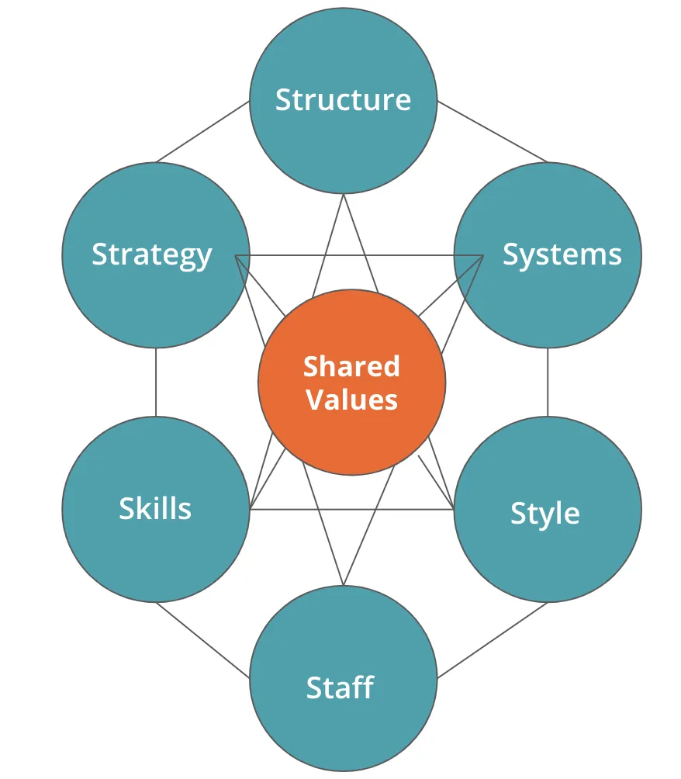
Mckensy's 7S

Slide 10
Mckensy's 7S
STRATEGY - The company delivers innovative IT solutions—software, AI, ML, cloud computing, and cybersecurity—while staying current with tech trends to support business growth.
STRUCTURE - 16 well-organized employees with clear roles, enabling smooth coordination and effective workflow.
SYSTEM - employs effective tools for project management, client communication, and internal tasks, including tracking systems and secure IT solutions.

Slide 11
Mckensy's 7S
STAFF - Skilled IT professionals and support staff receive regular training, enabling high-quality service delivery and continuous skill improvement.
STYLE - Leadership is friendly and participative, fostering teamwork, open communication, and ongoing learning to motivate and inspire creativity.
SKILLS - Excels in AI, ML, app development, cloud services, and cybersecurity, with strong problem-solving and project management skills for successful client outcomes.

Slide 12
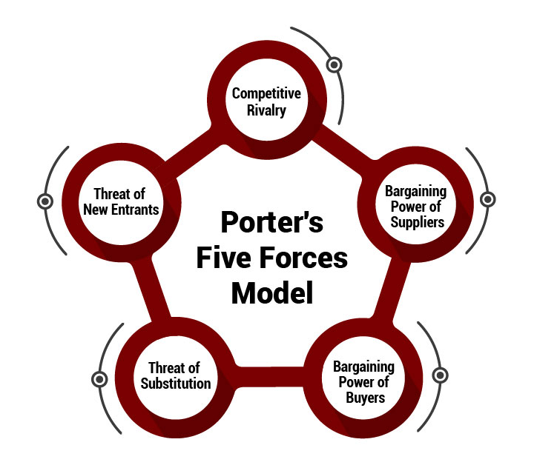
Porter’s FIVE Force Model

Slide 13
Porter’s FIVE Force Model
THREAT OF NEW ENTRANTS - Despite rising competition from a growing local IT sector, Vinyasa Tech Solutions’ strong reputation, skilled team, and solid client relationships maintain its competitive edge.
THREAT OF SUBSTITUTES - By delivering customized, innovative, and high-quality solutions, Vinyasa Tech Solutions offers greater value than generic or alternative IT options.
RIVALRY AMONG EXISTING COMPETITORS - Amid strong competition, Vinyasa Tech Solutions stands out through innovation, timely delivery, professional service, and lasting client relationships, continually improving to stay ahead.

Slide 14
Porter’s FIVE Force Model
BARGAINING POWER OF BUYERS - With multiple supplier options, Vinyasa Tech Solutions ensures quality, cost-efficiency, and timely tech resources despite varying supplier demands.
BARGAINING POWER OF SUPPLIERS - Vinyasa Tech Solutions fosters client loyalty by offering personalized solutions, reliable support, and strong communication, reducing risks from competitive customer choices.

Slide 15

SWOT Analysis

Slide 16
strengths
weaknesses
Skilled and Dedicated Team.
Customized IT Solutions.
Good Client Relationships.
Innovation and Continuous Improvement .
Limited Market Presence.
Small Team size.
Low Brand Awareness.
Dependence on Few clients.
OPPORTUNITIES
threats
Expansion to New Market.
Rising Demand for Digital solutions.
Partnership and Collaboration.
Adoption of Emerging Technologies.
Fast changing Technology.
Cyber Security Risks
Strong Competition.

Slide 17

Skills Learned
Hands-on IT company experience
Teamwork and communication skills
Creative design for social media
Improved attention to detail
Client interaction confidence
Positive client relationships
Digital marketing basics
Understanding online presence
Team coordination and deadlines
Time management skills
Creativity and professionalism
Adaptability to new tasks

Slide 18

challenges
Adapting to New Work Environment
Building Social Media Presence
Handling Initial Client Communications
Managing Time Effectively
Balancing Multitasking

Slide 19

Key takeaways and learnings
Improved Communication Skills
Creative and Technical Growth
Understanding of Digital Marketing
Teamwork and Collaboration
Professionalism and Time Management Skills
Personal Skills Development

Slide 20

Any Questions

Slide 21
Thank you
R SHRAVYA
USN: 4SH24BA070

